Slide 1
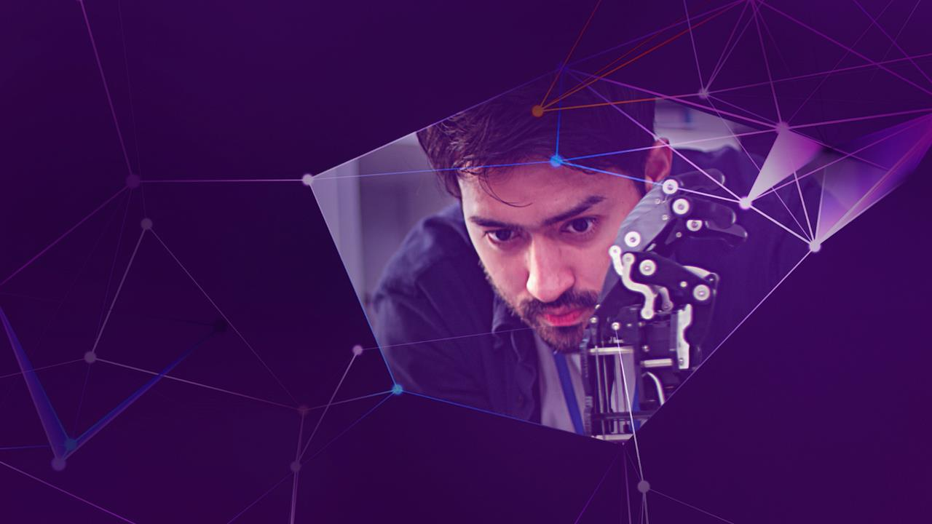

Accenture Innovation Challenge
Harness Generative AI to develop innovative solutions that boost business and societal growth

Slide 2

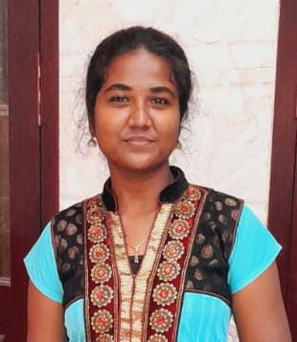
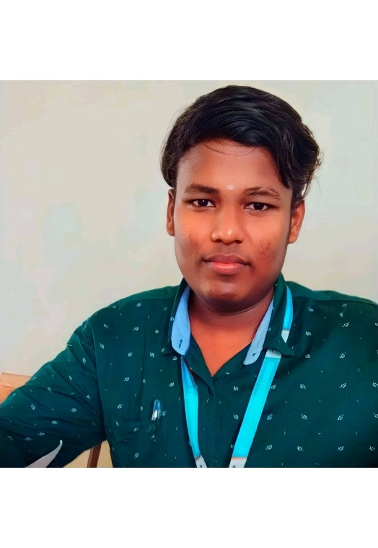
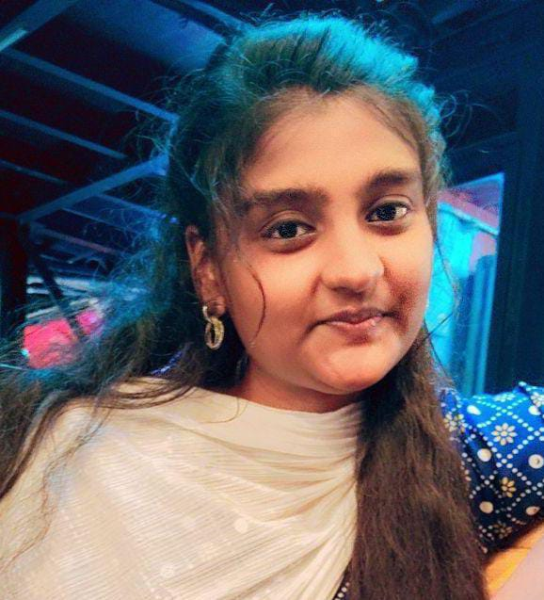
Team details
TEAM NAME: INNOVATIVEE MINDS
Ramya R
Sivananthan M (Team Leader)
College: Dhaanish Ahmed College of Engineering
Stream: Computer Science and Engineering
Year of graduation: 2025
College: Dhaanish Ahmed College of Engineering
Stream: Computer Science and Engineering
Year of graduation: 2025
Photo
Dineshkumar R
Swetha V
College: Dhaanish Ahmed College of Engineering
Stream: Computer Science and Engineering
Year of graduation: 2025
College: Dhaanish Ahmed College of Engineering
Stream: Computer Science and Engineering
Year of graduation: 2025

Slide 3
Describe the problem statement (200 words)
Telemedicine in Rural Area
Problem Statement : Rural areas face significant challenges in accessing timely healthcare due to limited medical facilities and unreliable infrastructure.
Access to essential medicines is a constant concern in rural areas because there are few pharmacies around or unreliable supply chains and logistical problems. Many rural areas are devoid of self-sponsored retail premises, for example, medical shops or drug stores and those that do still hardly have enough stock and timely delivery.
“ Inadequate or delay in access to necessary medications can have negative health impacts, cause unnecessary admissions to healthcare facilities and in some case worsen the disease. ” Along the same line, local chemists operating in rural settings are also faced by challenges such as assessing the medicine need and placing the orders on time.

Slide 4
Proposed solution / your big Idea (200 words)
Telemedicine in Rural Area
Telemedicine in Rural Area ,This solution suggests the use of Generative AI (Gen AI) for increasing the availability of critical medicine in remote places by combining AI-assisted diagnosis, online appointments, and drug delivery platforms. Symptoms can be entered through a smartphone application, which first provides some basic instruction, then connects the patients with physicians for video appointments and e-prescribing. The system makes it possible to place drug orders with local chemists and manages the stock with the help of AI that forecasts the amount of medicine required.
The Gen AI solution integrates machine learning (ML) and natural language processing (NLP) to enhance remote healthcare. ML analyzes patient symptoms using trained medical models, offering initial diagnosis and predictive insights for illness prevention. NLP enables multilingual support and voice/text recognition, making the platform accessible across regions.
ML-driven logistics optimize drug delivery routes and predict inventory needs for pharmacies, ensuring patients in remote areas receive timely medication and care, even when offline.
Describe TECHNOLOGY USED: Artificial Intelligence (AI), Natural Language Processing, Machine Learning, AI Voice Recognition

Slide 5
How does your innovation accelerate change with the power of Technology? (200 words)
Telemedicine in Rural Area
AI-Based Therapy: The generative AI you used for bingo provided instant diagnosis and suggestions and symptom interpretation in real time unlike the ordinary telemedicine apps. AI evolves further through constant use.
Emergency Response: Implement mechanisms to engage users with emergency call services and health facilities in the region, enabling timely aid in emergency situations.
Multilingual Voice Support: NLP enables the description of symptoms in any language, addressing literate, as well as illiterate and older persons to make it more accessible.
AI-Driven Drug Logistics: AI manages the supply of medicines including the expected demand for the medicines and the distribution to the rural drug stores.
All-in-One Solution: With the help of the AI-based diagnosis, online consultations with physicians and delivery of prescribed medicines, patients can receive complete health care needs through a single platform.

Slide 6
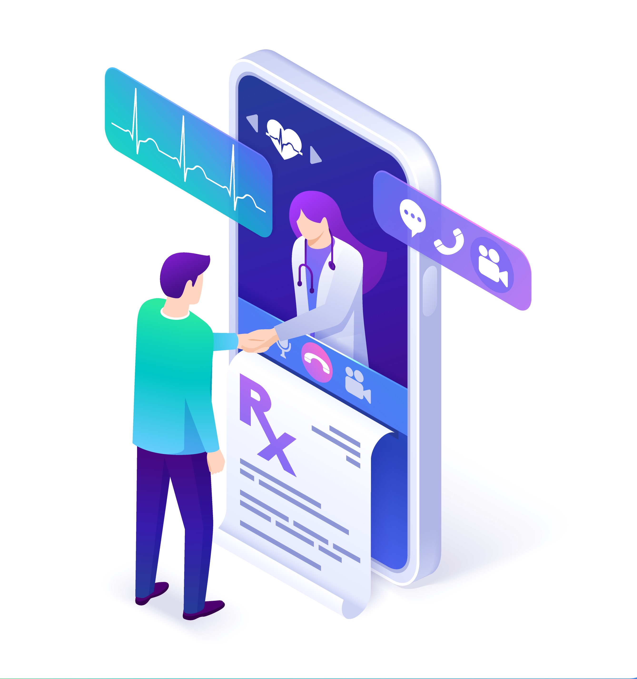
How is your solution different/unique from other solutions in market? (150 words)
Telemedicine in Rural Area
Generative AI for Dynamic Diagnosis: Unlike traditional platforms, your solution uses generative AI that adapts in real-time, continuously learning from new patient data to provide more accurate and personalized healthcare over time.
Multilingual and Voice Support: Patients can input symptoms using their native language, even through voice, making the platform accessible to non-literate users, elderly patients, and people in regions with diverse languages where other platforms may struggle.
PATENT FILED: No
Do you have a working model/prototype: No
If not, will you be able to show working prototype during finale. Yes

Slide 7
Any testimonials received?
We are still in the development phase, our primary focus is on building a solid product rather than seeking testimonials. Once we approach the launch or have a demo version available and early users to gather valuable feedback
Not yet received any Testimonials
Share the links/photos of the testimonials you’ve received
Notes:
Not yet received any Testimonials

Slide 8
Please share a 1-minute video of your idea (embed on this PPT or add a downloadable link)
Telemedicine in Rural Area
Click the link to view the video : Telemedicine in Rural area ideology video link
Notes:
Click the link to view the video :

Slide 9
Thank you!

